Slide 1
INTRO TO C#

Slide 2
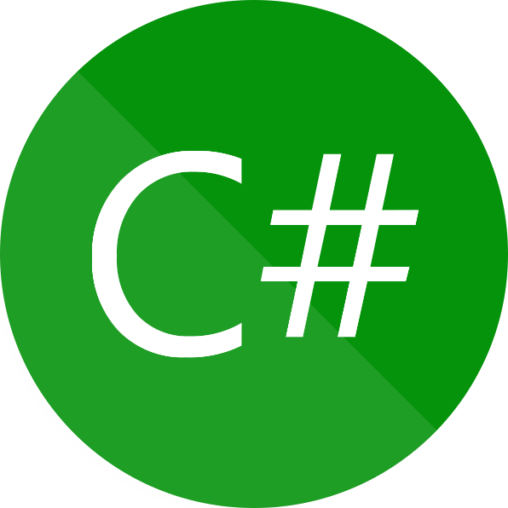
History of C#
C# was released in 2000 by a team led by Anders Hejlsberg
Designed by Microsoft to be a more complex language than Visual Basic but an easier language than C++
It fits within the .NET framework which allows you to use all the functionality of an operating system without having to code it. Eg: setting colours, sending emails, drawing functions etc.

Slide 3
Where is C# used?
C# is widely used in development companies
It was first used to mainly create desktop applications, but can now also be used to create Web and mobile applications
It is widely used with Unity (Game development Engine) and Xamarin (Mobile development)

Slide 4
Development Environment
Microsoft Visual Studio
The Microsoft tool for developing in C# is Visual Studio. The community edition is free when you sign up with Microsoft
Visual studio includes different languages such as Visual Basic and Java
Visual studio allows you to create different types of “Projects” such as: programs with forms or programs which are based in the console
There are other online environments which will allow you to run and test code, these are useful if you are using a non-windows operating system such as IOS.
Notes:
All instructions will be shown using Visual Studio
But online environments will work for simple things. Reading in files may be an issue, and prior testing is advised.
https://dotnetfiddle.net/
https://repl.it/
https://rextester.com/

Slide 5
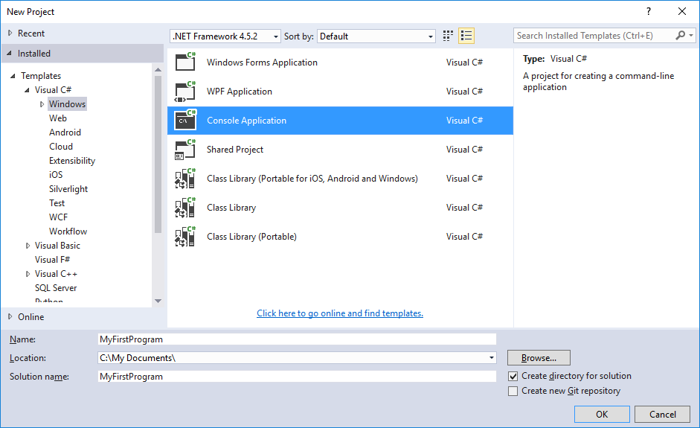
TASK: Your first program
Open Visual Studio and create a project
Choose C# - WINDOWS – CONSOLE APPLICATION
Change the Name of your project to “MyFirstProgram”
Change the Location to somewhere of your choice
CLICK OK
Naming your programs checklist:
Is it a name which describes the program?
Is it short?
Does it have no spaces?

Slide 6
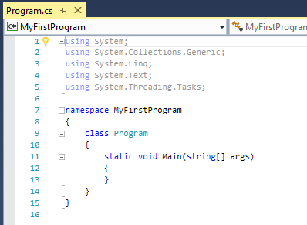
Task: Your first program
You should see something similar to the image on the right ->
You can see three sets of Braces
In between the middle set you are going to type the following:
Console.writeline will print whatever is in the round brackets into the console (Screen)
Console.Read() makes the computer wait for some input before continuing
Console.WriteLine(“Hello, World!”);
Console.Read()

Slide 7
What do the words mean?
public - any other class can access this method
static - exists as part of a class object (in general our variables & methods will always be static)
void - does not return a value (generally all methods are either void or return a value)
String[]args - describes the optional input to the main method in a command line environment
Main - statements of the program should be written between the braces of the Main method.

Slide 8
Why write console programs?
Console programs are a quick way to create programs! You don’t let interfaces and special buttons etc get in your way.
They are often used in programming competitions or programs which are going to be run by the developer to process data.

Slide 9
C# Programming Conventions
Programming conventions are important to create a standard in programs.
They make it easier for others to view and edit your code
The following are a few good conventions to follow, refer to the links for more detail:
References:
https://docs.microsoft.com/en-us/dotnet/csharp/programming-guide/inside-a-program/coding-conventions
https://www.dofactory.com/reference/csharp-coding-standards
https://www.c-sharpcorner.com/UploadFile/8a67c0/C-Sharp-coding-standards-and-naming-conventions/

Slide 10
C# Programming Conventions
Naming:
Class names and methods, use Pascal Case (upper letter at the start, and upper letter for every new word) eg: ClearScreen
Class names have a verb, they are an action eg: DrawPlayer, MovePlayer etc
Variables use camel Case ( lower letter at the start and upper letter for every new word) eg: redPlayerArm
Use the word or abbreviation to describe the object
button or btn eg: btnStart
form or frm eg: formLevel1
pictureBox or pic eg: picPlayer

Slide 11
C# Programming Conventions
Layout
Line up curly brackets under each other
Declare variables at the top of a method
Declare static (public) variables at the very top
Write one statement per line
Indent code below methods, loops, conditions 1 tab stop (4 spaces)
Leave a gap under methods

Slide 12
C# Programming Conventions
Commenting
Place comment on a separate line
Begin comment with a capital letter
Insert a space between the // and the start of the comment eg: // Make the …
Should be used to explain the code below the comment
Can be used to explain what something does and why
Notes:
Note: this can be at the discretion of the teacher. You may wish to specify things like:
All methods must have a comment.
Your name and id number must be at the top of every program

Slide 13
Variables
Variables are names given to identify an allocated piece of data.
The data can be changed and retrieved in your program
In c# variables have to be declared (set up)
Variables also have to be a specific data type
Using the correct variable type is like allocating the right parking space of vehicles

Slide 14
Variables
Examples of most commonly used data types are:
int integer or a number with no decimals
double a number which can have a decimal component
bool boolean or only true or false values
char character which is any character typed on a keyboard
String a series of characters usually given within quotes “”
Variables are declared by using the key word (above) and provided a name. They can be given a value when declared or later in the program eg:
int x; OR int x = 34;
String name; OR String name = “Jane”;

Slide 15
Writing data to the screen
Use Console.WriteLine() or Console.Write()
What is the difference?
Yes: WriteLine adds a carriage return to the end of the output (ie: a new line)
In the brackets you specify the output, this can be a mix of variables or string text in quotes.
Eg: Console.WriteLine(“This is the start of the output.”);
Console.WriteLine(“My name is “ + name);
Using a + in between string text and a variable is called concatenation

Slide 16
Challenge #1
Create a program which introduces yourself to the person running your program.
Create variables to store
Your name
Age
Favourite food
Number of people who live in your house
Which suburb you live in
Tell a story to the user (use extra Writeline() commands to put in extra spaces)
“Have you” check list:
Used good variable names
Used correct data types
Commented your code
Added the correct spacing in your output
Notes:
Suggestions for teachers: I like to create a bit of competition, I’ll either offer a lolly to the first 3 or 5 to complete the challenge. Or have them tick the challenges off on a wall chart.
You could also create a collaborative environment and encourage a whole group to complete the task, more competent students can then assist others.

Slide 17
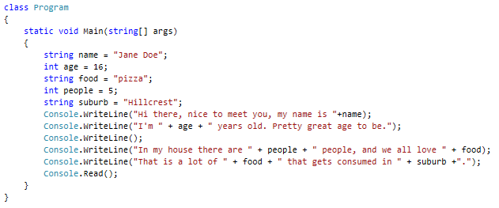
Challenge 1 Example

